Slide 1


Presentation By
01
Md Jahangir Alam
222182038
Dept. of CSE

Slide 2
Roadside Stalls, Traffic Flows, and Pedestrian Safety
Roadside Stalls
Problems for roadside stalls
Why it Raises so fast
Mitigate these problems

Slide 3
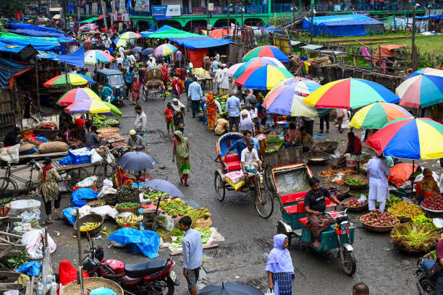
What is Roadside Stall ?
Roadside stalls are small, informal businesses operating along streets and sidewalks.
Economic role : jobs, low cost service
Legal Status: No official registration exists
Consumer Base : lower middle class
Benifits : affordable, accessible

Slide 4
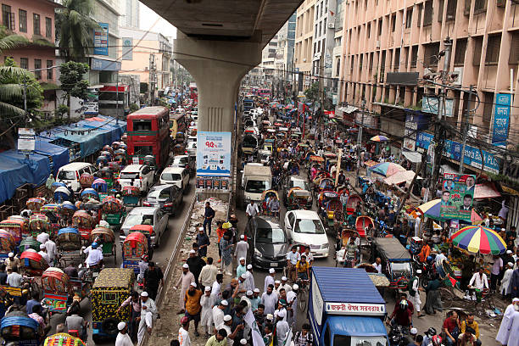
Problems for Roadside Stalls
60% of footpaths illegally occupied in dhaka city
Traffic Flow Disruption
Pedestrian Safety Risks
Road Space Encroachment
Public Health & Sanitation Issues
Regulatory & Governance Challenges
Social & Cultural Conflicts

Slide 5
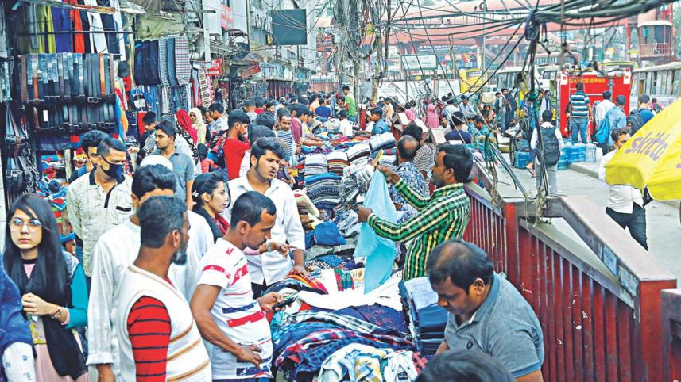
Why Roadside Vendors Raises So Fast ?
Massive Urban Migration :
High Consumer Demand:
Low Barrier to Entry :
low initial capital
lack legal recognition

Slide 6
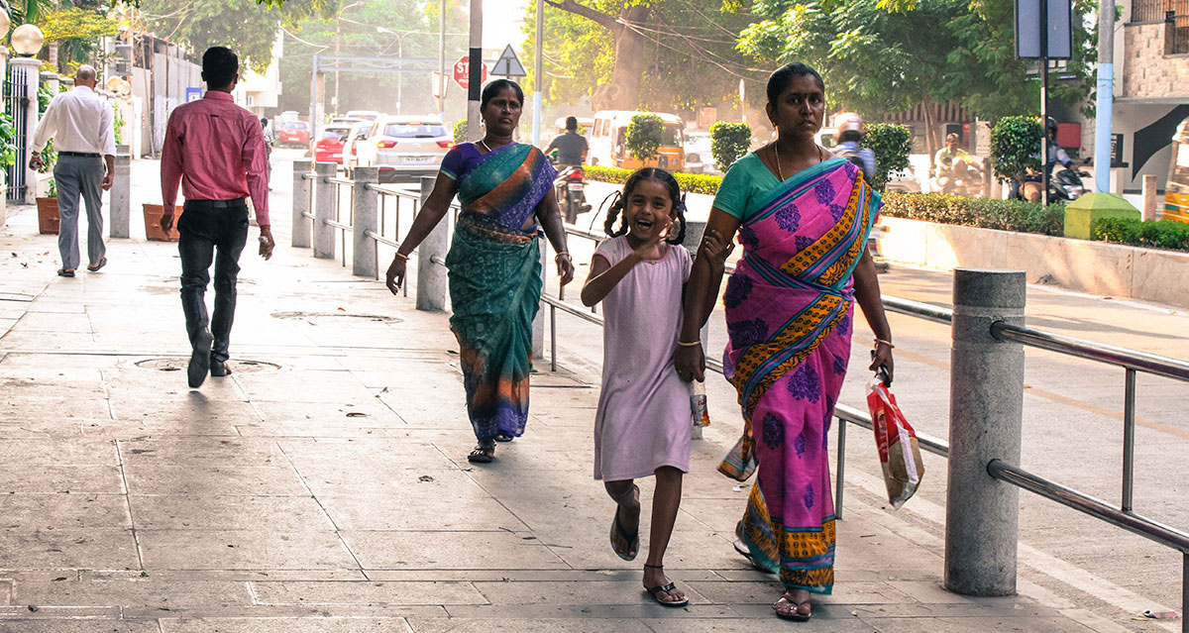
Mitigate Strategies
Designate specific areas for street vendors
Allocate zones where vendors can operate without blocking sidewalks or roads.
Pedestrian-Oriented Footpath Design
Footpaths should have sufficient width for safe walking.
Restrict vending in high-traffic areas
Vendor Registration & Policy Frameworks
Issue IDs or licenses to vendors
Supports fair regulation and protects vendor livelihoods.
Public Awareness & Safety Initiatives
Conduct campaigns about safe walking, crossings, and traffic rules.

Slide 7
thank
you

